Slide 1


How to use Excel Templates
HCMG 4450

Slide 2
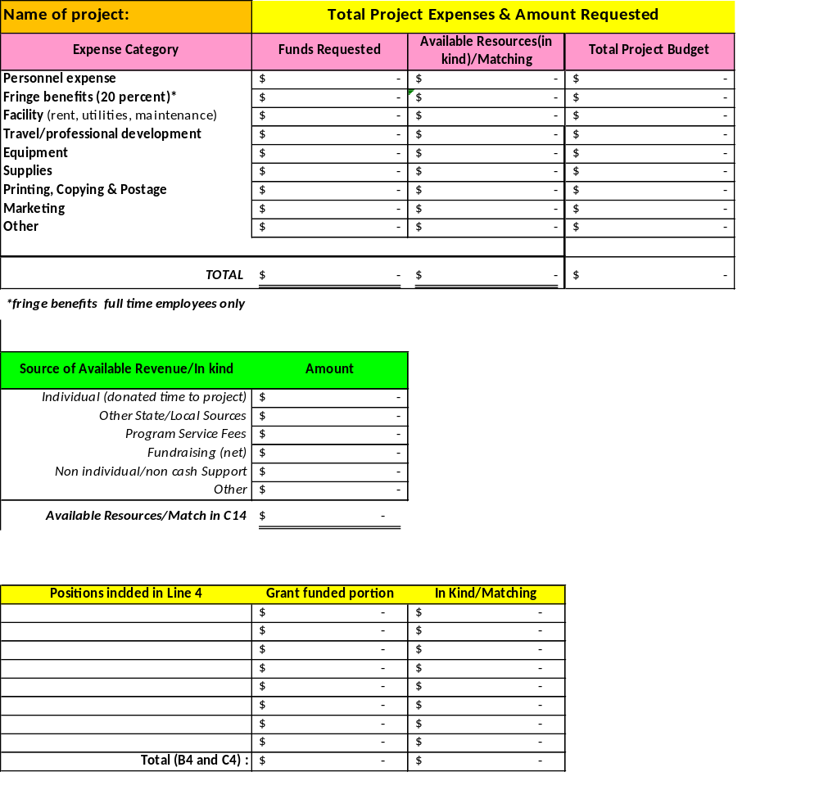
Open the Excel Proposal Budget Template

Slide 3
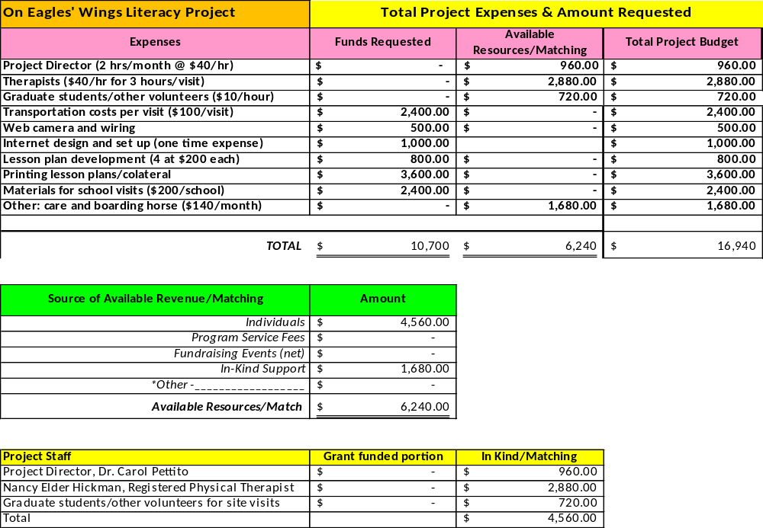
Budget
Estimate and project your costs using the Excel template; save it.

Slide 4
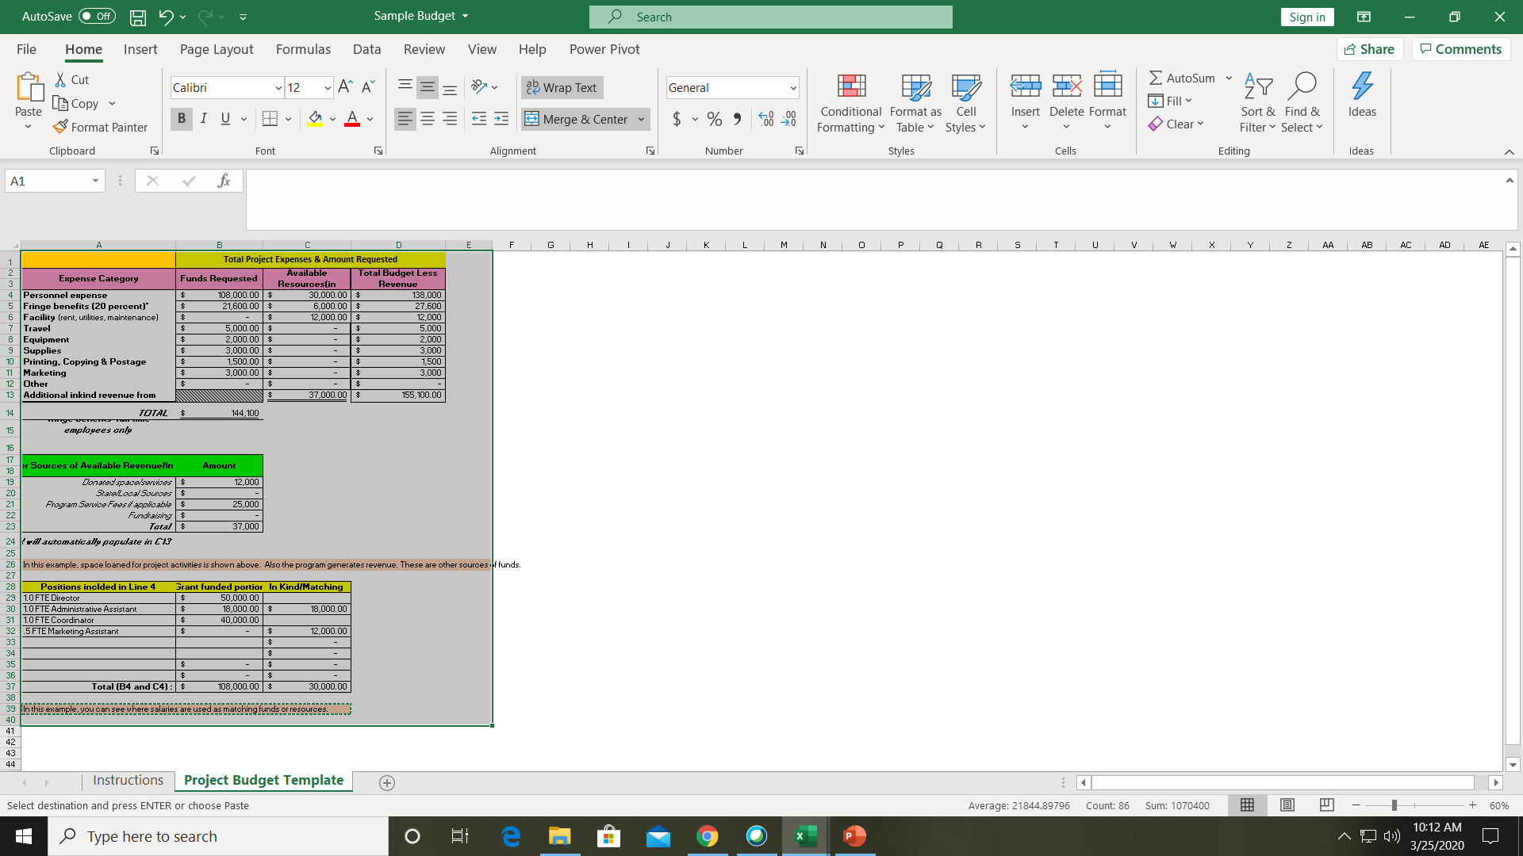
Highlight the completed budget and click “copy”

Slide 5
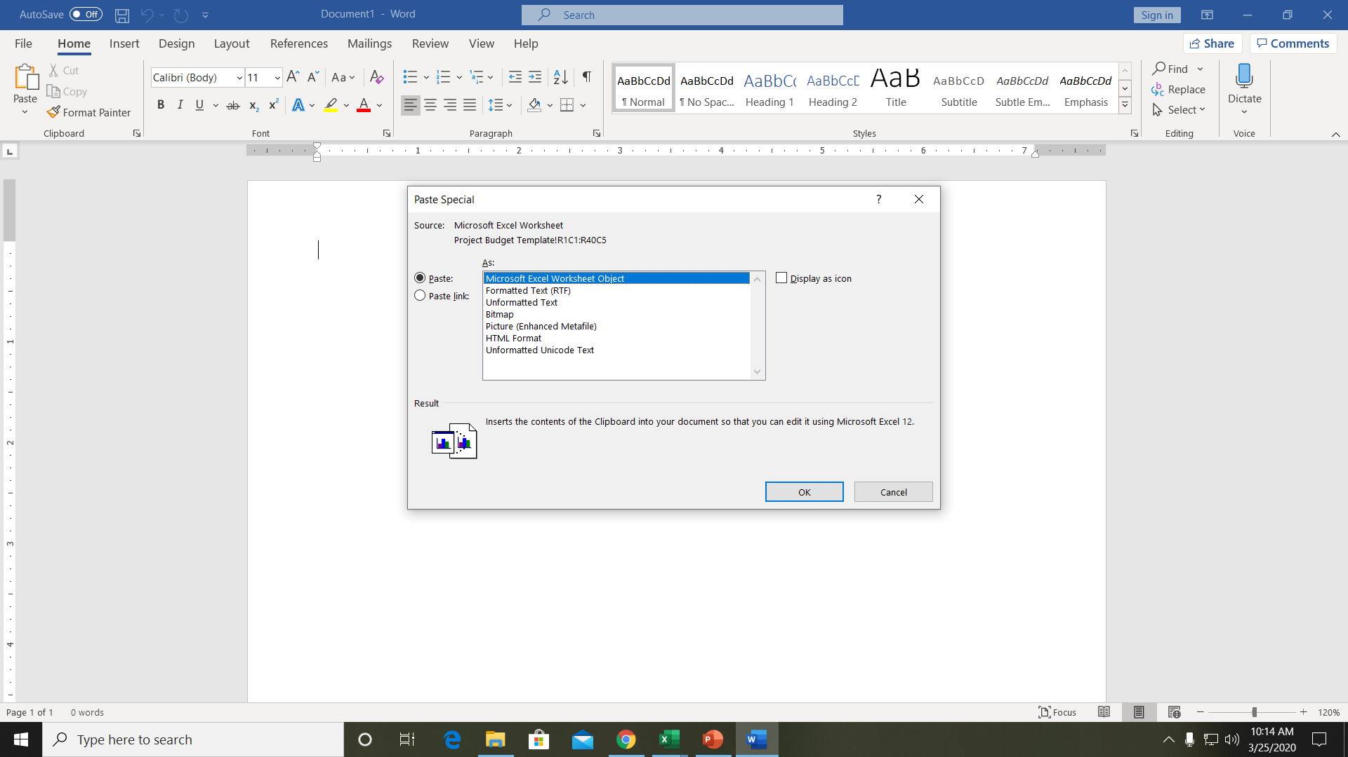
After you copy it, open your Word document and click “Paste” then “Paste Special”… then click “Microsoft Excel Worksheet Object”

Slide 6
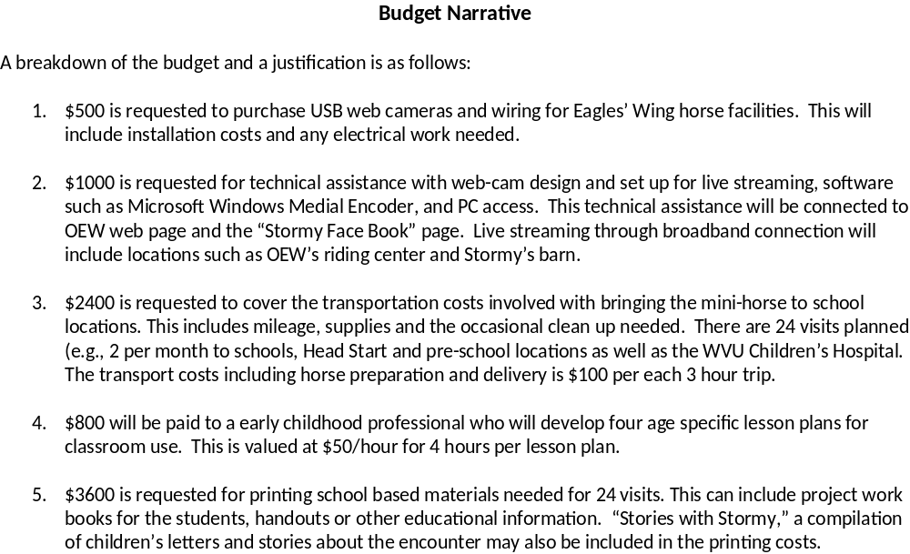
Budget Narrative
The budget narrative is where you justify projected expenses. This explains why you need the money you requested. (This is about one page).

Slide 7
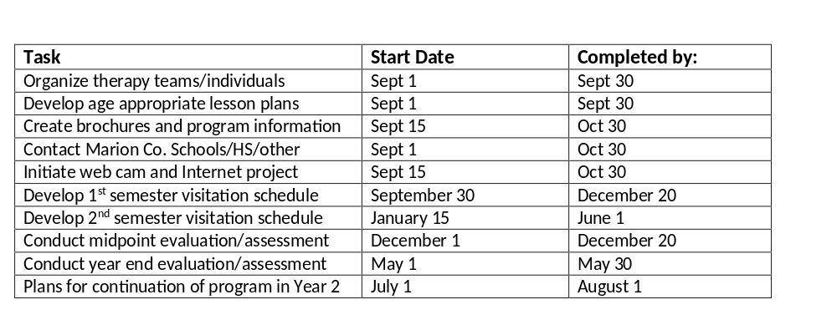
Timeline/GANTT chart
The next section is headed Timeline and is visual guide for deliverables (these should relate to budget and objectives). This explains what order you plan to accomplish key tasks to implement the program.

Slide 8
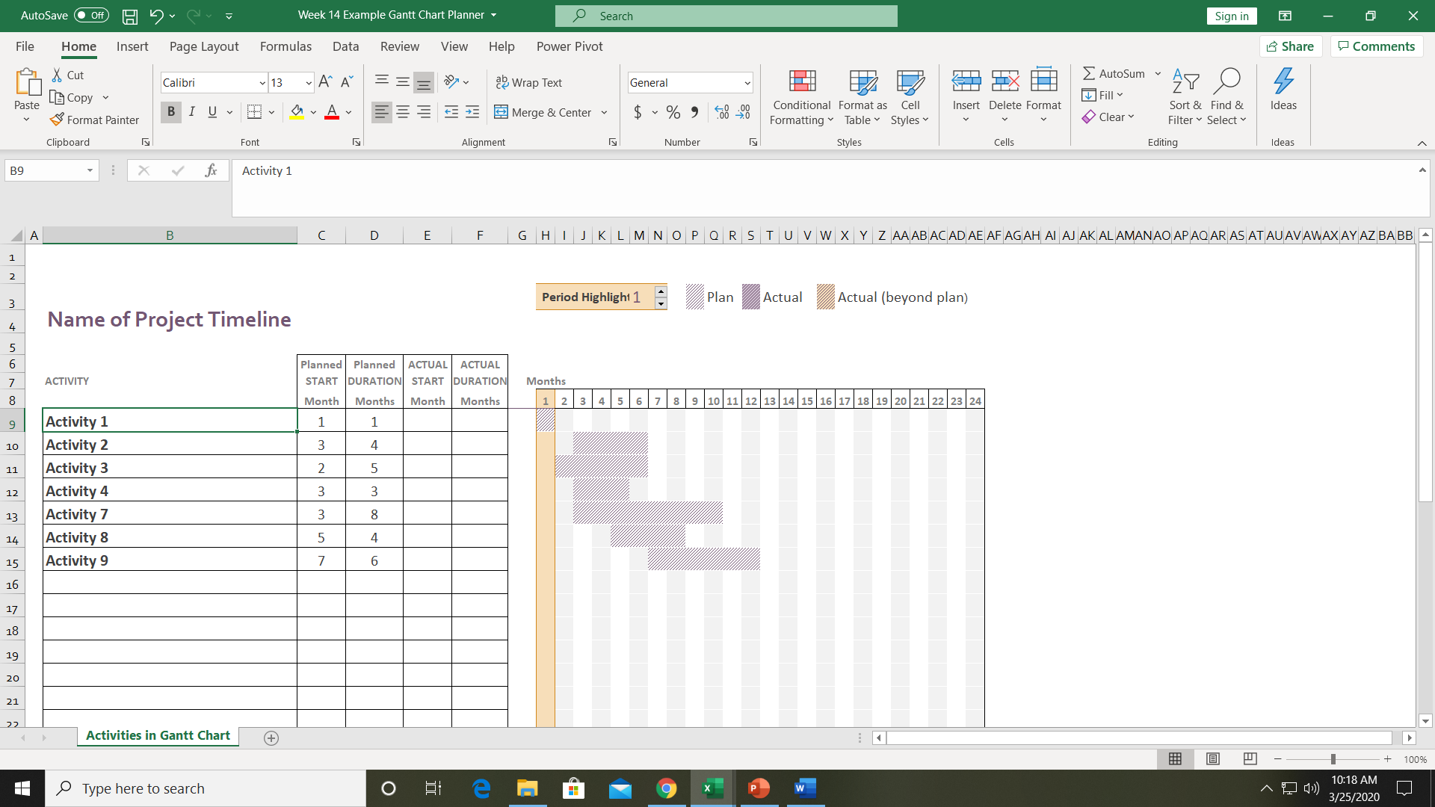
This should be a logical listing of steps needed in order to implement your project. Change the title (name of Project) and describe the activities.

Slide 9
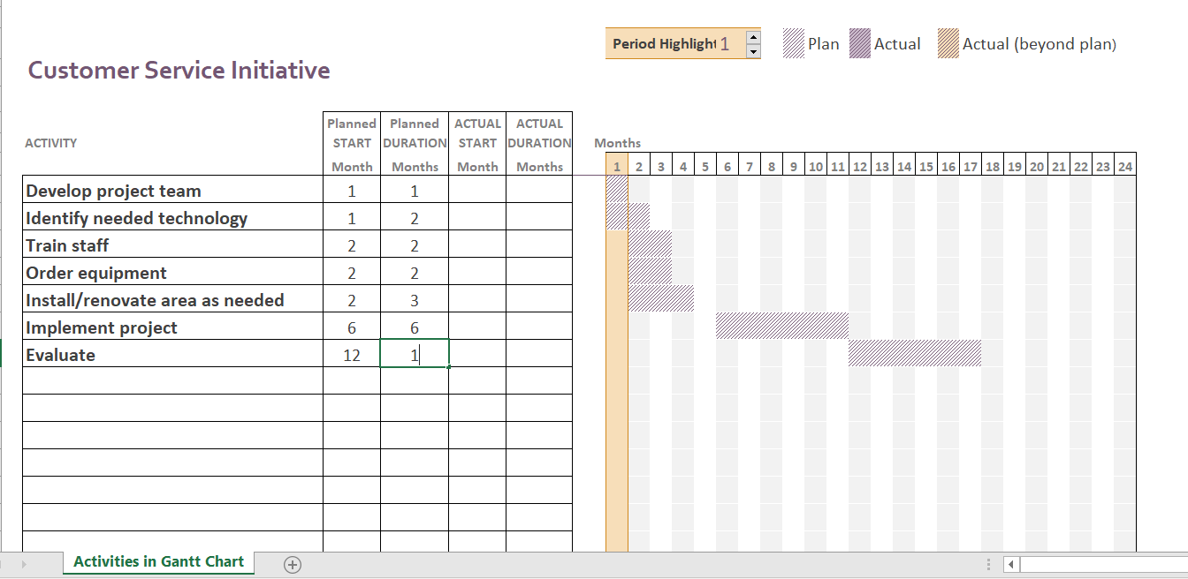
In this example, you can see how the title was edited and the activities were described, then identified when they would start and how long it would take. This is envisioned to start in month 6 and be evaluated in month 12.

Slide 10
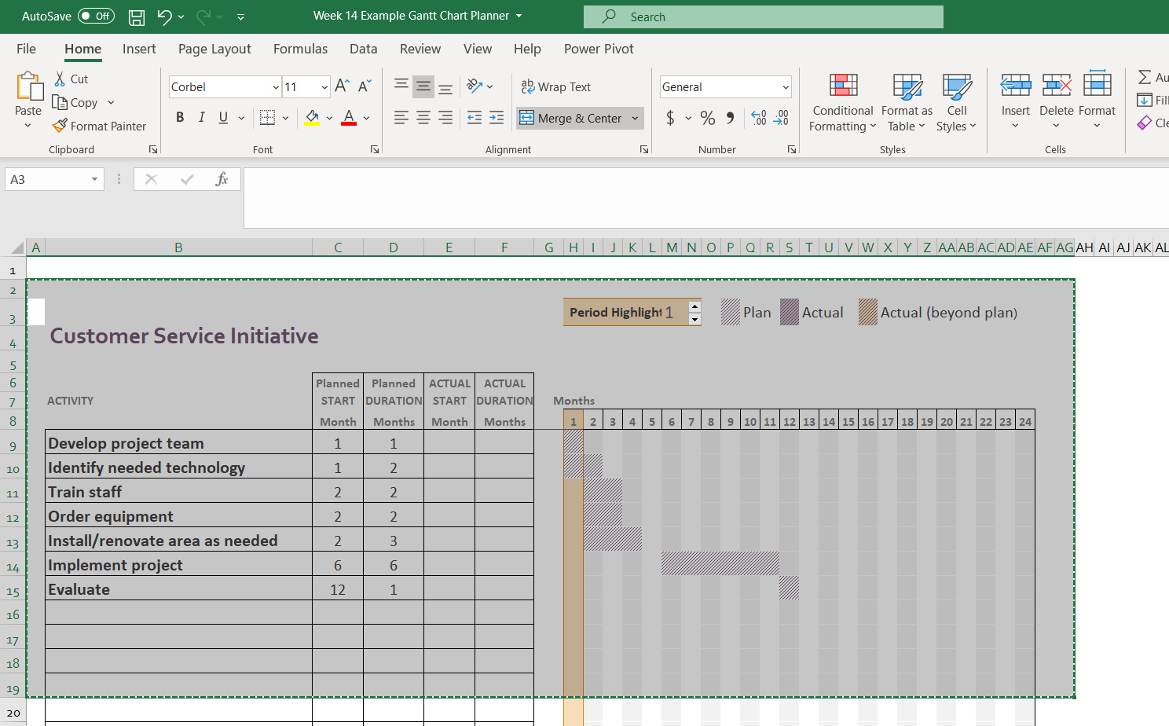
Save your spreadsheet; highlight the area to be copied

Slide 11
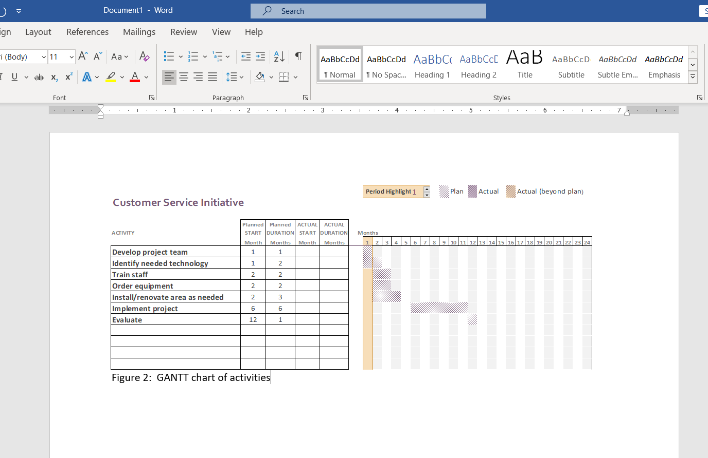
When you insert as a Microsoft Excel object, you may have to reduce it to fit on the paper. Always label these charts as “figures” below the information shown.

Slide 12
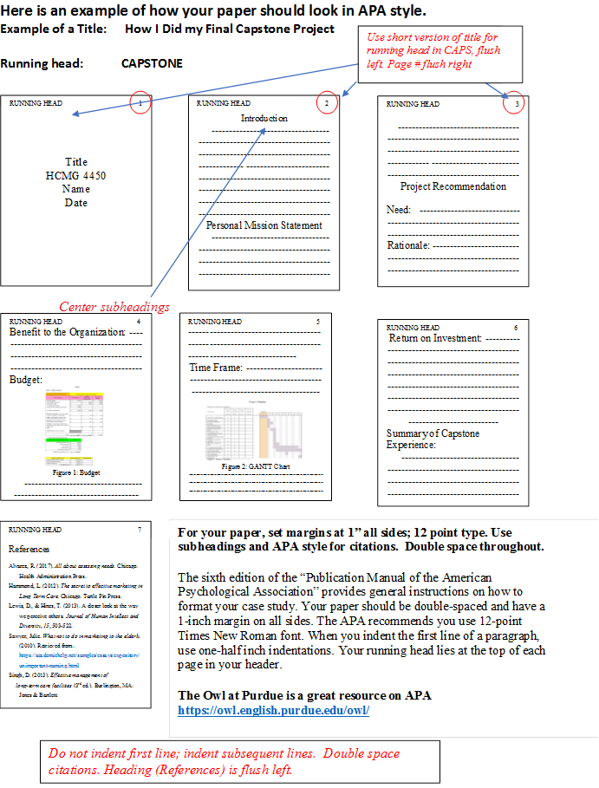
Your paper should look like this:

